Slide 1
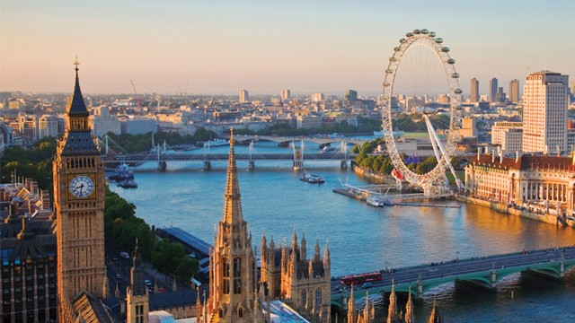
Real Estate Prices & Venues Data Analysis of London

Slide 2
Background
London is the capital of United Kingdom and is the largest city in UK. With the largest municipal population in the European Union, London has a diverse range of people and cultures, and more than 300 languages are spoken in the region. Its estimated population is 9.30 million according to the UN's World Urbanization Prospects, the most populous city in the European Union and accounting for 13.4% of the UK population. London’s urban area is the second most populous in the EU, after Paris, with 9,787,426 inhabitants at the 2011 census. The population density is 14,500/sq mi.

Slide 3
Problem
London is a city with a high population and population density. As from Real Estate investor point of view we want to invest in such places were the housing prices are low and the facilities (shops, restaurants, parks, Hotels, etc.) and social venues are nearby. Keeping above things in mind it is very difficult for an individual to find such place in such big city and gather this much information. When we consider all these problems, we can create a map and information chart where the real estate index is placed on London and each district is clustered according to the venues.

Slide 4
Data Collection
Data was collected from several website which are-
List of areas of London and London Boroughs
Website-https://en.wikipedia.org/wiki/List_of_areas_of_London
List of latest housing prices in London
Website-https://propertydata.co.uk/cities/london
Foursquare API
Website-https://developer.foursquare.com
GeoJson file of London Boroughs
Website-https://joshuaboyd1.carto.com/tables/london_boroughs_pro per/public
London Boroughs Outline
Website-https://skgrange.github.io/www/data/london_boroughs.json

Slide 5
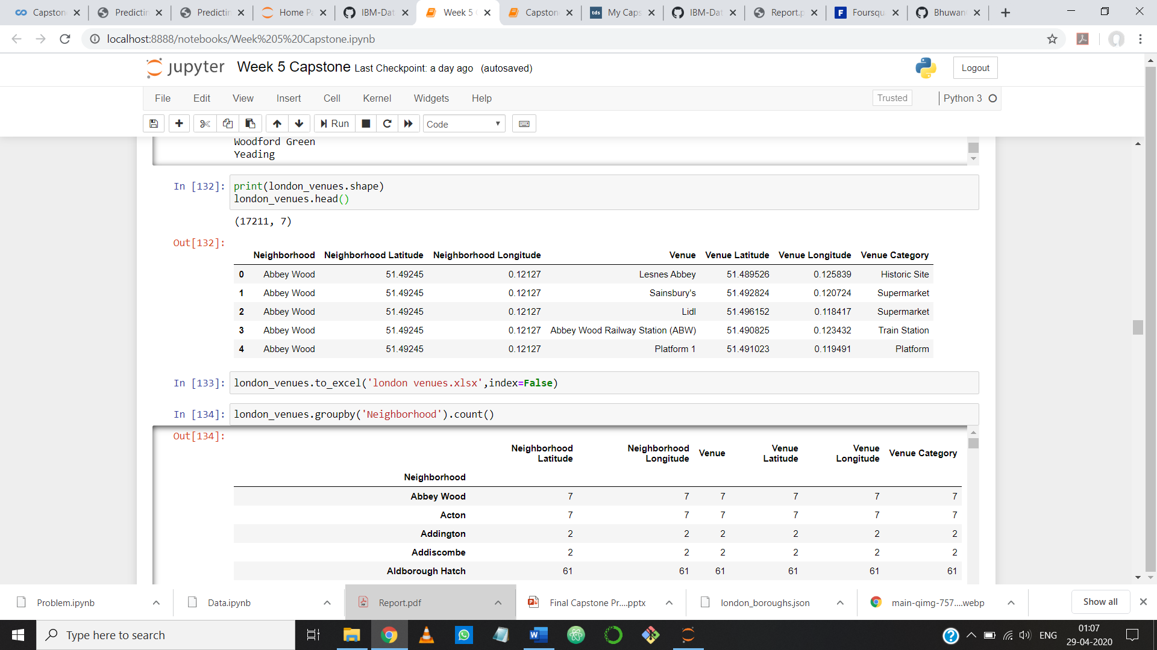
Data Pre-Processing
Data collected from Wikipedia and data on Real estate was cleaned first.
Removed all the hyperlinks and there are more than one Postal codes for some Locations so I kept only one Postal code. First of all I removed all null values and then get rid of unwanted columns and only kept ‘Area’ and ‘Avg price’ columns. Then ‘Avg Price’ columns contains string so I processed it to make integer by removing pound sign and comma. After cleaning two tables I performed inner join and merge two table and from resulting table I dropped ‘Dial Code’ and ’OS grid ref’ columns as they were of no use. Then by using geocoder library I find the Longitudes and Latitudes of the Location and add a columns of each in my dataframe.

Slide 6
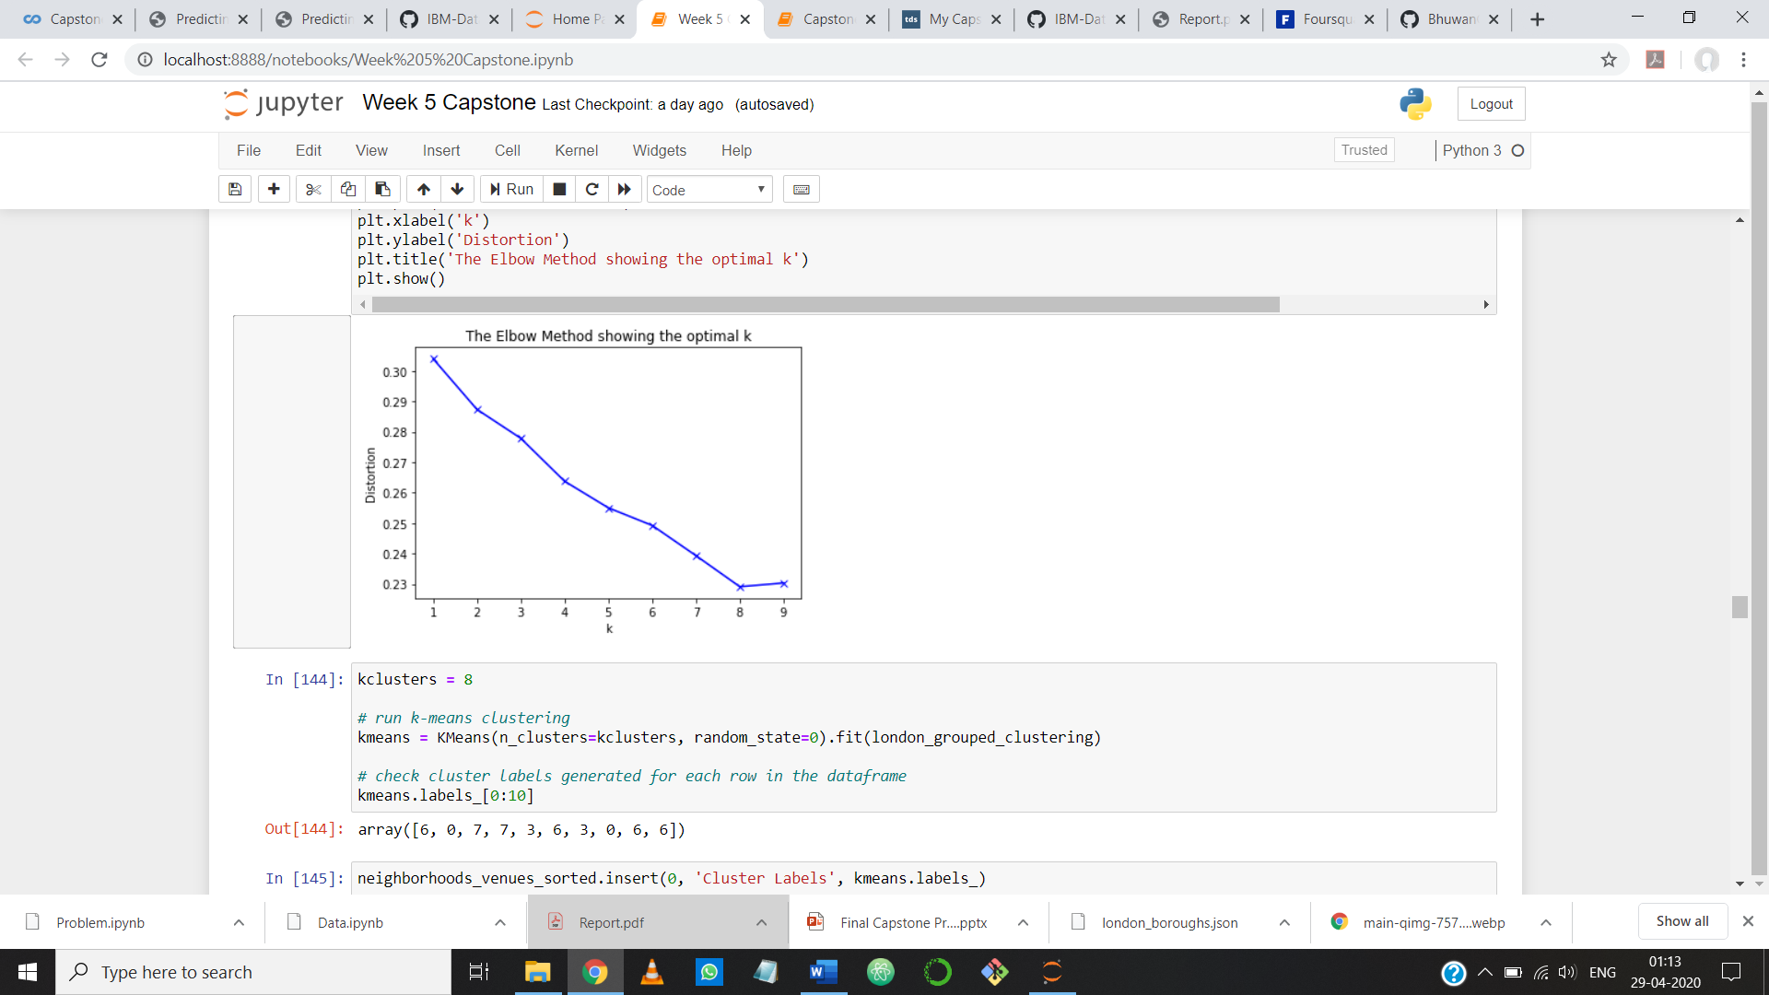
Machine Learning
We have some common venue categories in boroughs. In this reason I used unsupervised learning K-means algorithm to cluster the boroughs. K-Means algorithm is one of the most common cluster method of unsupervised learning.
Firstly I ran K-Means algorithm to find out best K using elbow method. From the curve it was evident that best K is 8.
Then I ran K-Means to cluster the boroughs into 8 clusters .Then I merged table with cluster labels for each borough.

Slide 7
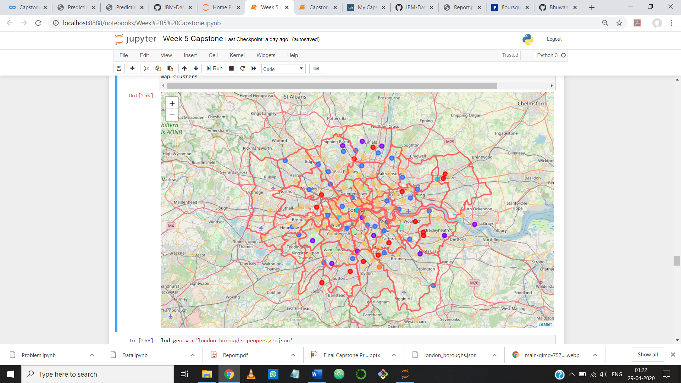
Map of London with Clusters

Slide 8
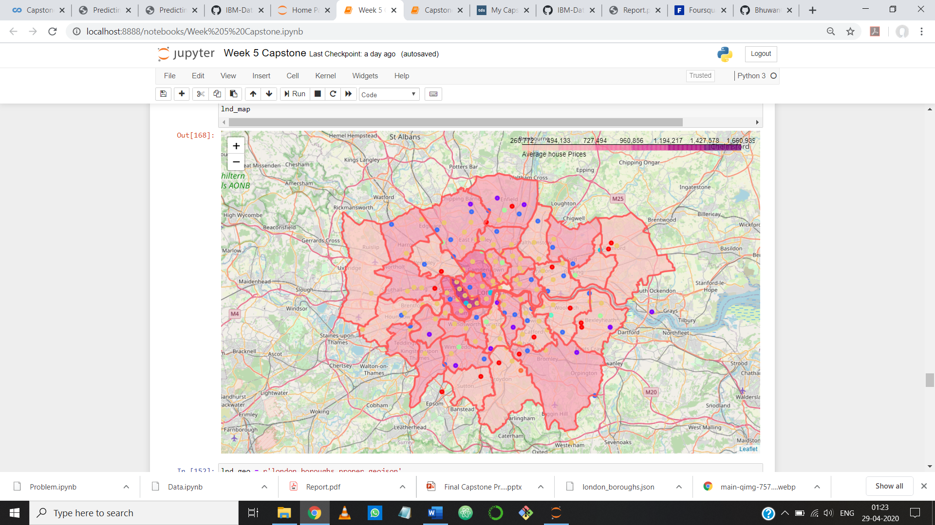
Choropleth Map for visualizing London Boroughs and Avg Price

Slide 9
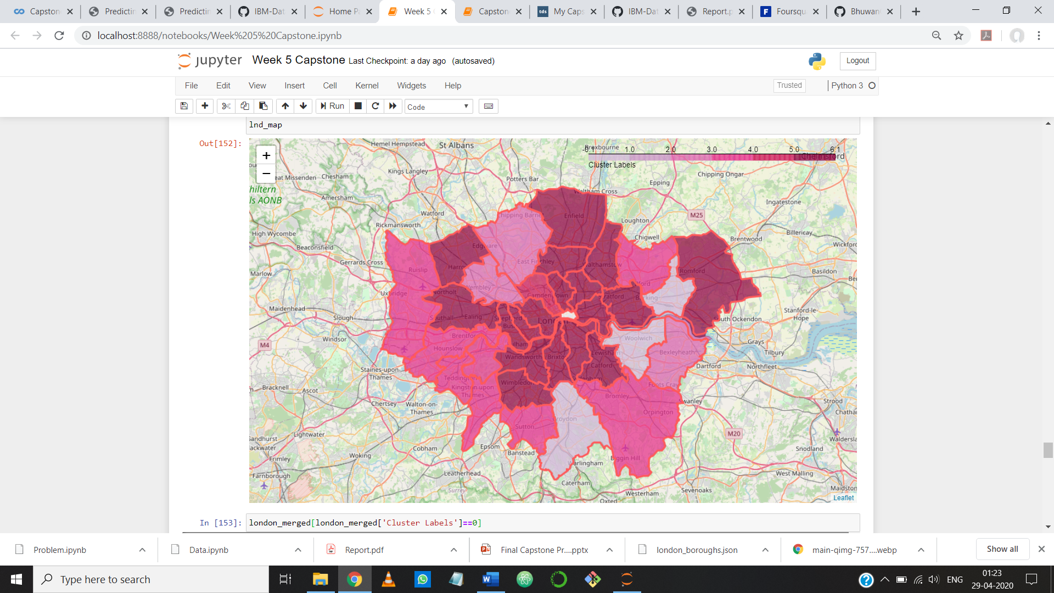
Choropleth Map for visualizing London Boroughs and Clusters

Slide 10
Result
I came to the result that the house prices in the downtown and with Hotels and Social venues nearby are very high.
While in the suburbs and the neighbourhoods away from the city centre have low prices but the facilities are also good. Almost all low price neighbourhoods are close to restaurants, pubs, sports facilities etc.
Some Boroughs such as Westminster, and Kensington and Chelsea have very high house prices. Bexley, Croydon, and Sutton Boroughs have very low house prices but have good venues to visit nearby.

Slide 11
Conclusion
As people are turning to big cities to start a business or work. For this reason, people can easily interpret where to live with all facilities and cheaply.
Not only for investors but also city managers can manage the city more regularly by using similar data analysis types or platforms.

